Slide 1
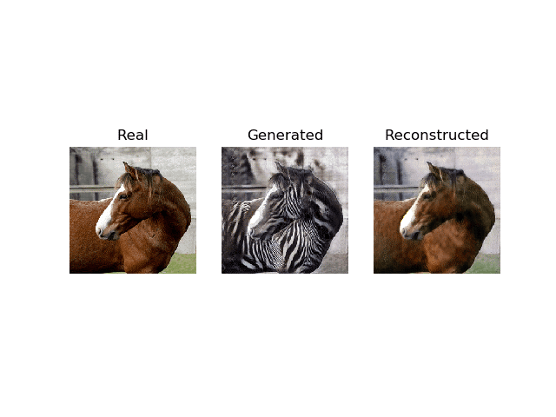
Image to Image Translation using Cycle GAN
Machine Learning Project
Sem 7
By:
Manav Ukani
(20BCP167)
Jenis Gundaraniya
(20BCP157)

Slide 2
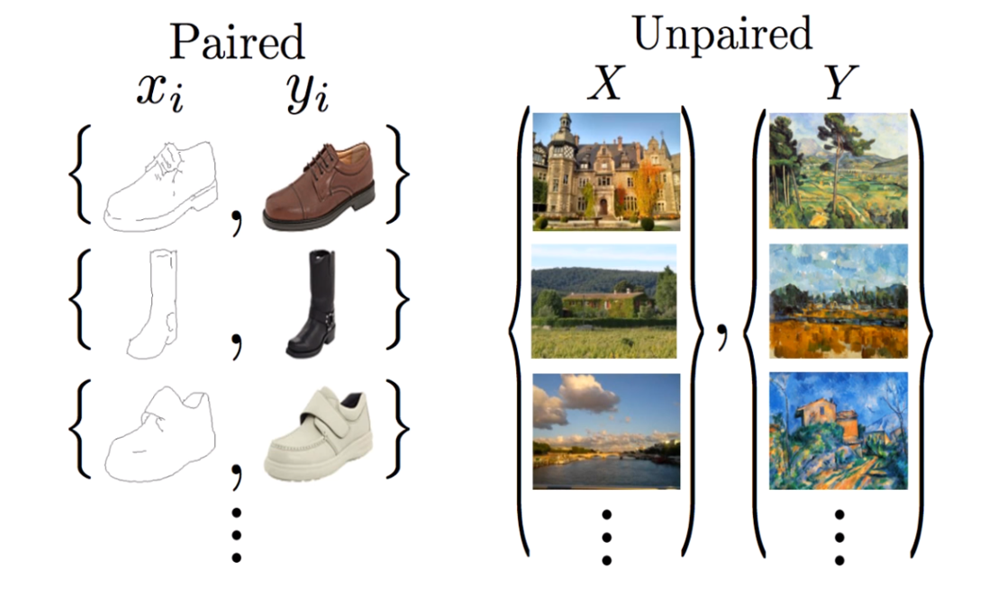
Introduction
Generative Adversarial Networks (GANs) are a type of neural network used for image generation.
Consist of two networks:
Generator: creates fake images
Discriminator: distinguishes between real and fake images.
GANs solves image-image translation problems without paired data
ref. https://arxiv.org/abs/1703.10593

Slide 3
Literature Survey
Paper Name | Authors | Purpose | Findings
Generative Adversarial Nets | Ian JG, Jean PA, Mehdi M., Bing Xu, David WF, Sherjil O., Aaron C., Yoshua B. | Adversarial networks for generative models without the need for explicit modeling or approximate inference. | Effective at training generative models via a minimax game.
Image-to-Image Translation with Conditional Adversarial Networks | Phillip Isola, Jun-Yan Zhu, Tinghui Zhou, Alexei A. Efros | Investigate conditional adversarial networks for versatile image translation. | Pix2Pix, Effective at synthesizing photos, reconstructing objects, and colorizing images with wide applicability.
Unpaired Image-to-Image Translation using Cycle-Consistent Adversarial Networks | Jun-Yan Zhu∗, Taesung Park∗, Phillip Isola, Alexei A. Efros | Develop a method for image translation without paired data using cycle consistency. | Successful in tasks involving color and texture changes but faces challenges with geometric changes.

Slide 4
Literature Survey
Paper Name | Authors | Purpose | Findings
Unsupervised Representation Learning with Deep Convolutional Generative Adversarial Networks | Alec Radford, Luke Metz, Soumith Chintala | Bridge supervised and unsupervised learning with deep convolutional GANs. | Deep Convolutional GANs are strong candidates for unsupervised learning and provide useful features for various tasks.
Conditional Generative Adversarial Nets | Mehdi Mirza, Simon Osindero | Introduce conditional GANs for conditional image generation. | Preliminary results show potential for conditional adversarial nets in generating MNIST digits conditioned on class labels.

Slide 5
Dataset description
The dataset enables developing conditional generative adversarial networks, pixel-level domain adaptation, image style transfer, and other image-to-image translation techniques.
The dataset captures the significant appearance changes in Yosemite between summer and winter seasons, while maintaining overall scene layout and geometry.
Feature | Description
Source | UC Berkeley
Images | 1279 photos (summer/winter)
Image Type | Unpaired
Image Size | 256 x 256 pixels
Image Format | JPEG
Classes | 2 (Summer, Winter)
Train/Test Split | 80%/20%
Applications | Image-to-image translation, pixel-level domain adaptation, conditional GANs, style transfer

Slide 6
Proposed method
Define the Problem - convert images of summer scenes to images of winter scenes
Preprocess - include resizing, normalization, and data augmentation.
Define GAN Architecture – CycleGAN and parameters like learning rate, batch size, and number of epochs
Train Discriminator to distinguish "real" Vs "fake" data
Train Generator synthesize data
Repeat training steps
Once training is complete, synthesize data from Generator

Slide 7
Current status – cyclegan architecture
while the discriminator network learns to distinguish between the generated images and real images.
The generator network learns to map input images from one domain to the other domain.
CycleGAN uses two GANs, one for each direction of the translation task.
G
G: X -> Y
GAN (Y2X) loss
GAN (X2Y) loss
D_{X}
X
Y
D_{Y}
Ensures that the generator network produces images that are consistent with the input image.
The discriminator network learns to distinguish between the generated images and real images.
Cycle consistency loss
Cycle consistency loss
F
F: Y -> X
The generator and discriminator networks are trained simultaneously in an adversarial manner to improve the quality of the generated images.

Slide 8
Cycle-Gan working
The CycleGAN algorithm involves the minimization of two loss functions:
Adversarial Loss:
computed by the discriminator network
generator tries to minimize the adversarial loss
Cycle-consistency Loss:
reduces the number of mapping G can take
used to ensure that the generated images are consistent with the input image.
computed by comparing the original input image and the image generated by the generator network with each other.

Slide 9
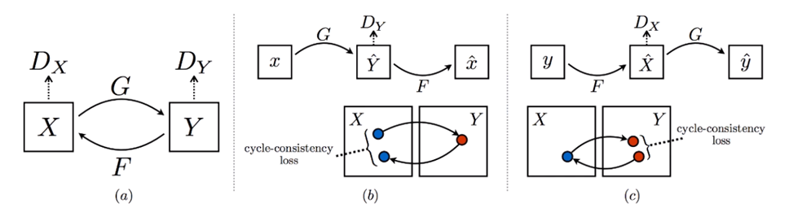
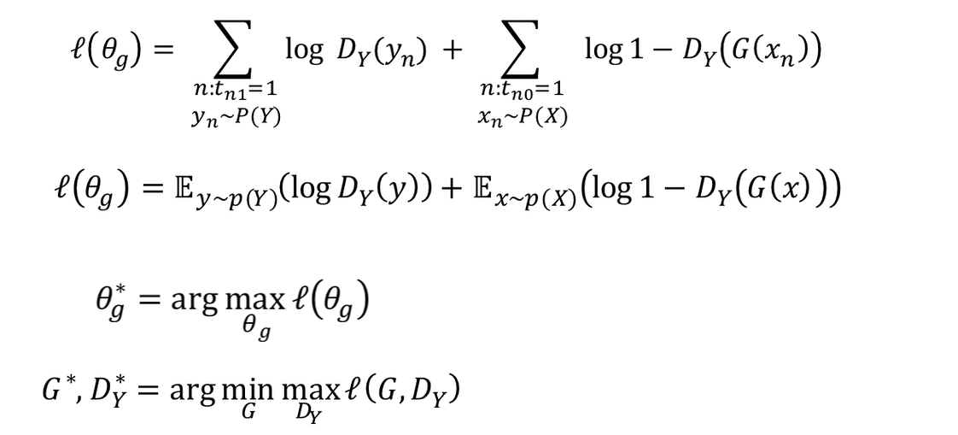
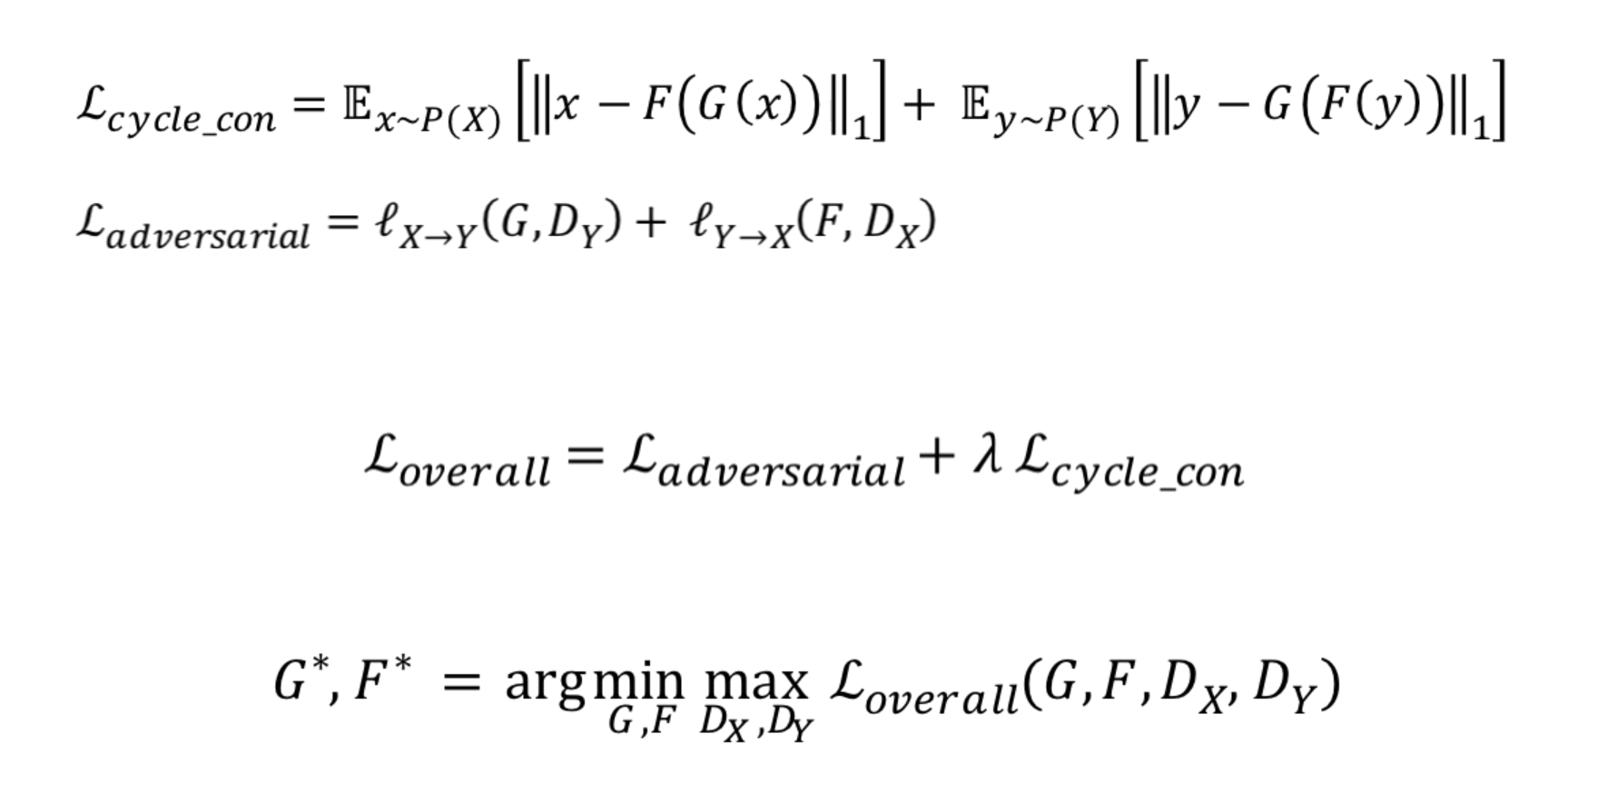
Mathematics behind cycle-gan
control relative importance of adversarial network

Slide 10
referneces
https://people.eecs.berkeley.edu/~taesung_park/CycleGAN/, Accessed on 19th September, 2023
Mirza, M. and Osindero, S., 2014. Conditional generative adversarial nets. arXiv preprint arXiv:1411.1784.
Goodfellow, I., Pouget-Abadie, J., Mirza, M., Xu, B., Warde-Farley, D., Ozair, S., Courville, A. and Bengio, Y., 2014. Generative adversarial nets. Advances in neural information processing systems, 27.
Isola, P., Zhu, J.Y., Zhou, T. and Efros, A.A., 2017. Image-to-image translation with conditional adversarial networks. In Proceedings of the IEEE conference on computer vision and pattern recognition (pp. 1125-1134).
Zhu, J.Y., Park, T., Isola, P. and Efros, A.A., 2017. Unpaired image-to-image translation using cycle-consistent adversarial networks. In Proceedings of the IEEE international conference on computer vision (pp. 2223-2232).
Radford, A., Metz, L. and Chintala, S., 2015. Unsupervised representation learning with deep convolutional generative adversarial networks. arXiv preprint arXiv:1511.06434.

Slide 11
THANK YOU

